Slide 1


Boosting Campaign & Client Retention with Data Analysis
A Data-Informed Approach to Retention
Presented by
Kenneth Akonnor Hayford

Slide 2

Overview of CreativePulse Media
Project Overview: Using data to improve campaign performance and retain clients at CreativePulse Media.
Focus: The project focuses on improving campaigns, client reporting, and audience insights to help retain clients.
Insights: The data shows which campaigns work best and what keeps clients engaged.
Goal: To use data to improve campaign performance and retain clients.
Problem Statement: Clients are reviewing their contracts due to unclear insight into the effectiveness of their marketing campaigns.

Slide 3
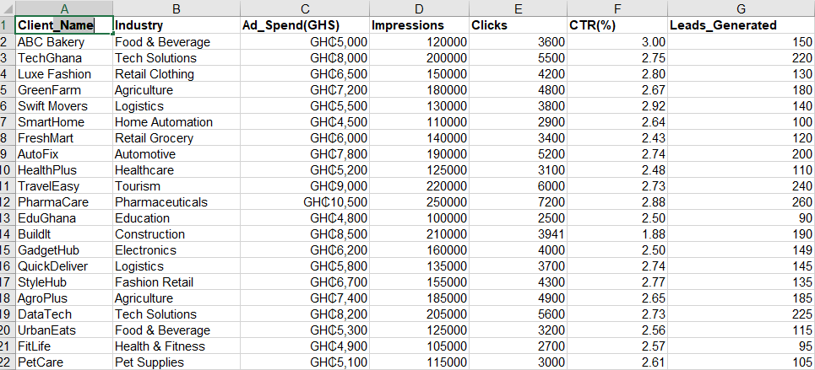
DATA OVERVIEW
DATA OVERVIEW
The dataset includes detailed campaign performance metrics such as impressions, clicks, leads generated, and engagements across platforms, clients, with their status helping identify what drives engagement and results.
DATA DESCRIPTION
The data contains industry information, ad spends, client names, target demographics, performance metrics (CTR, conversions, engagement rates, and costs), and status, enabling comprehensive analysis of campaign effectiveness.

Slide 4


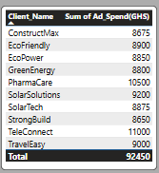


ANALYSIS AND FINDINGS
Key Insights:
CreativePulse serves a total of 100 business clients
The Total Amount spent by Clients amounted to GHS658,000
The Total Spending of the top 10 clients of CreativePulse amounted to GHS92,450
An Average of Clicks to Impression ratio was recorded as 2.60(%)

Slide 5
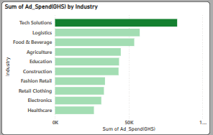
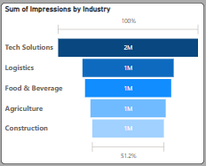
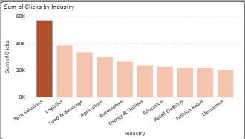
Key Insights:
Tech Solutions had the highest ad spend among all industries, resulting in 2 million impressions, nearly 60,000 clicks, and the highest performance across all sectors.

Slide 6
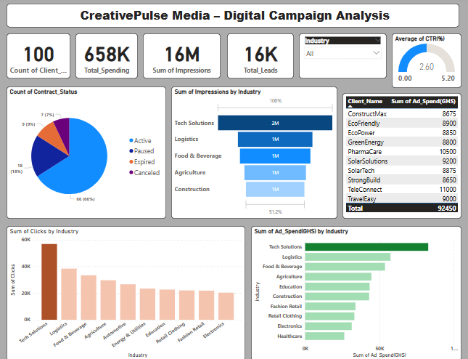
CREATIVEPULSE MEDIA -DASHBOARD
VISUALIZATIONS
Trends & Patterns
Tech Solutions: Highest impressions (2M), but low engagement.
Logistics: Most effective is an almost 40K clicks from just 1M impressions.
Food &Beverage, Agriculture, Construction: 1M impressions, fewer clicks – average performance.
Clicks are more evenly spread than impressions, with high exposure ≠ and high engagement.
Retail & Electronics: Low engagement may need better creatives or targeting.
VIEW DASHBOARD HERE

Slide 7

RECOMMENDATIONS
Optimize the Tech Solutions campaign to improve engagement rates
Invest more in logistics ads, as they drive the most clicks from fewer impressions
Reassess targeting for Food & Beverage and Agriculture to boost performance
Revamp creatives for Retail & Electronics to increase audience interaction
Focus the budget on high-engagement industries, not just the high reach
Refine audience targeting in sectors with high impressions but low clicks
CONCLUSION
Implementing these recommendations will enhance campaign effectiveness and improve client satisfaction. Focusing on engagement-driven strategies ensures better results across key industries.
RECOMMENDATIONS &CONCLUSION

